Slide 1
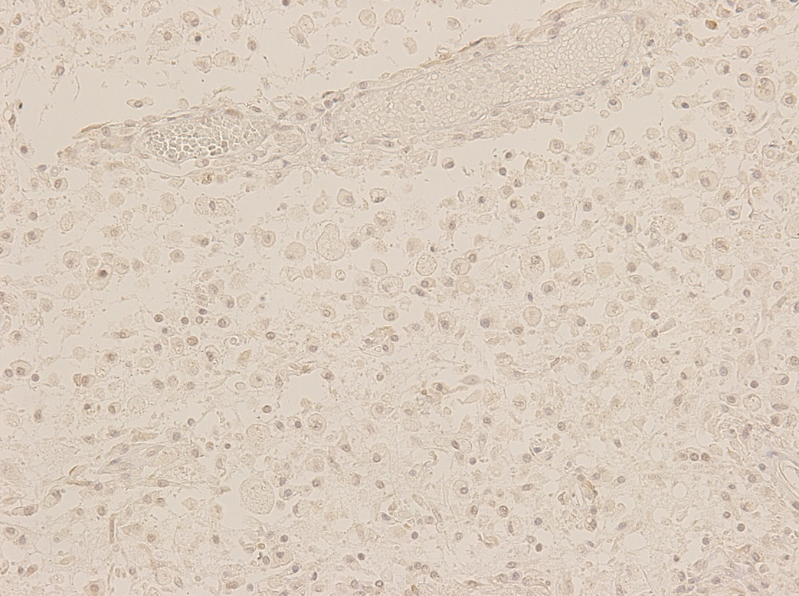
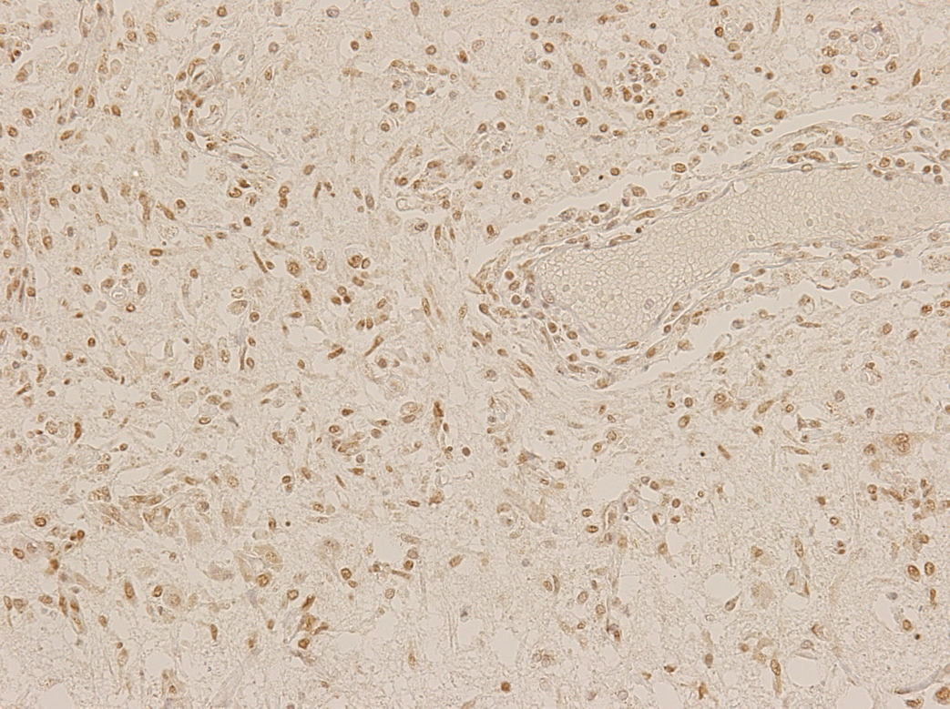
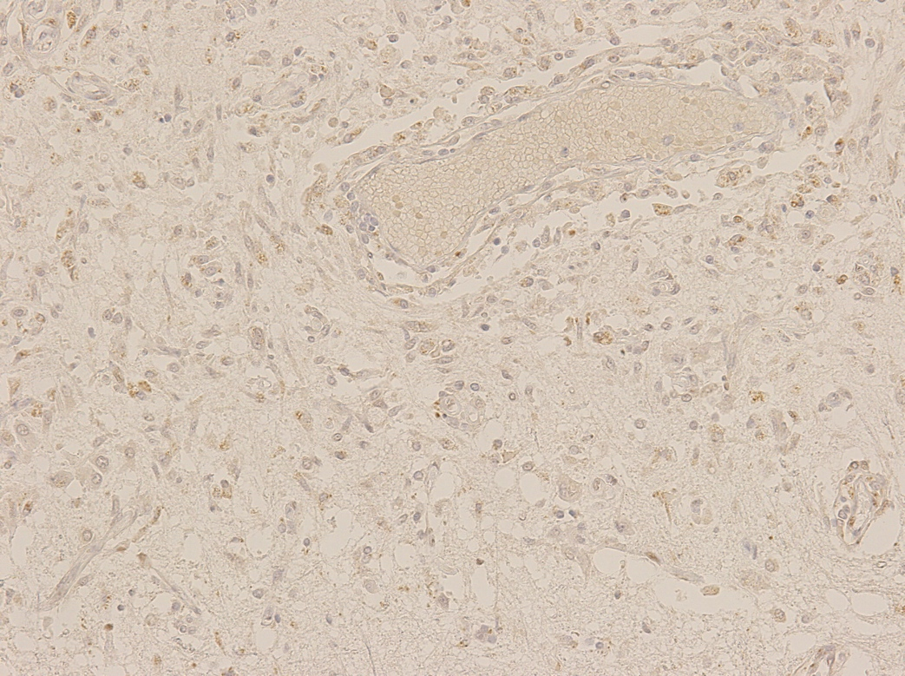
A
B
C
Figure 1.
Expression of CIRBM(A), RBM3(B) and HSP70(C) in the infarction with necrotic
neural tissue.
CIRBM and HSP70 were weakly expressed
surrounding infarct area. RBM3 was
intensively expressed in the cells and
endothelial cells of blood vessels.

Slide 2
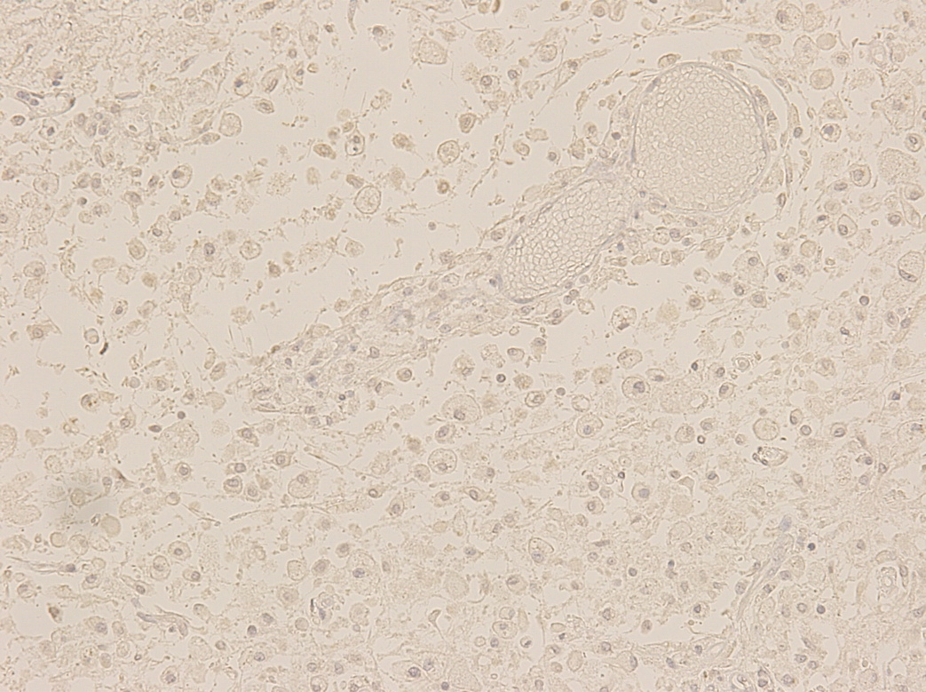
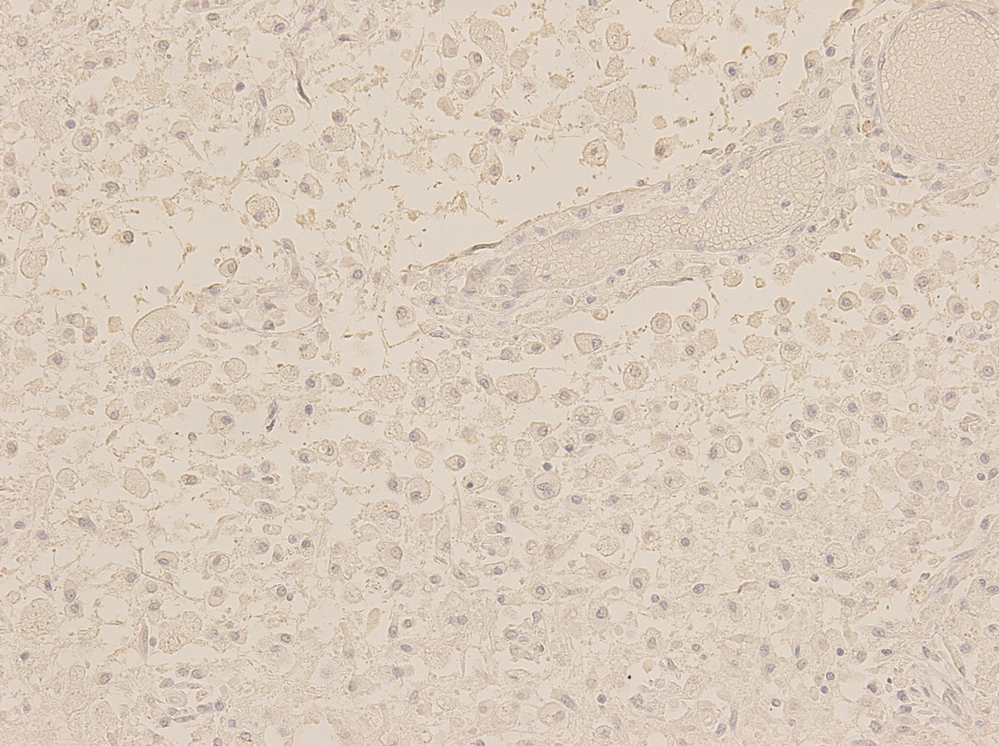
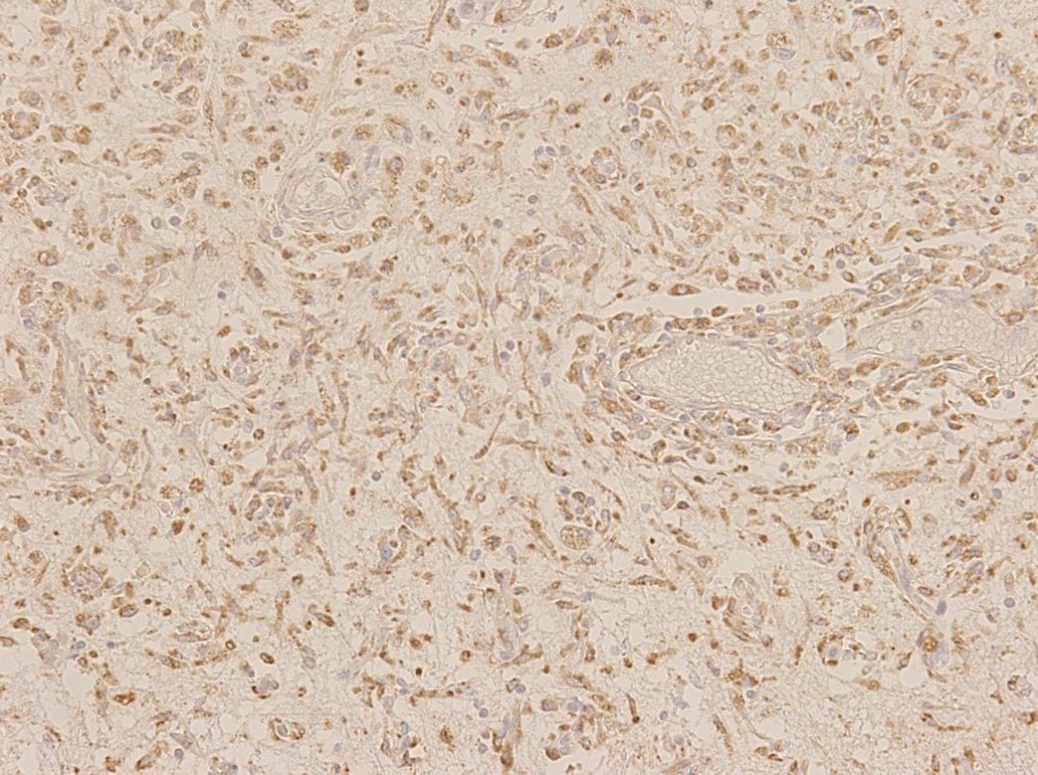
A
B
C
Figure 2.
Expression of HIF1, VEGF and
eNOs in the infarction with necrotic neural
tissue.
Although expression of HIF1 (A) was feeble,
that of VEGF (B) was weak and that of eNOs
(C) was clearly in macrophages. Expression
of eNOs was stronger than that of infarction
with bleeding and expressed in the
endothelial cells of blood vessels.

Slide 3
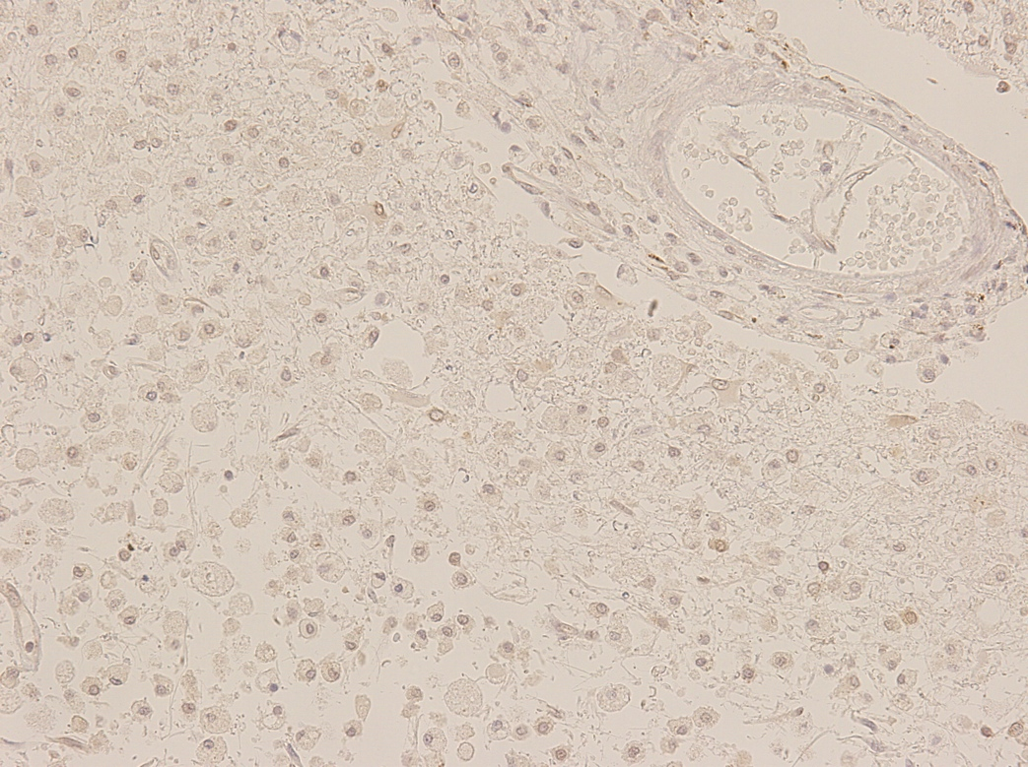
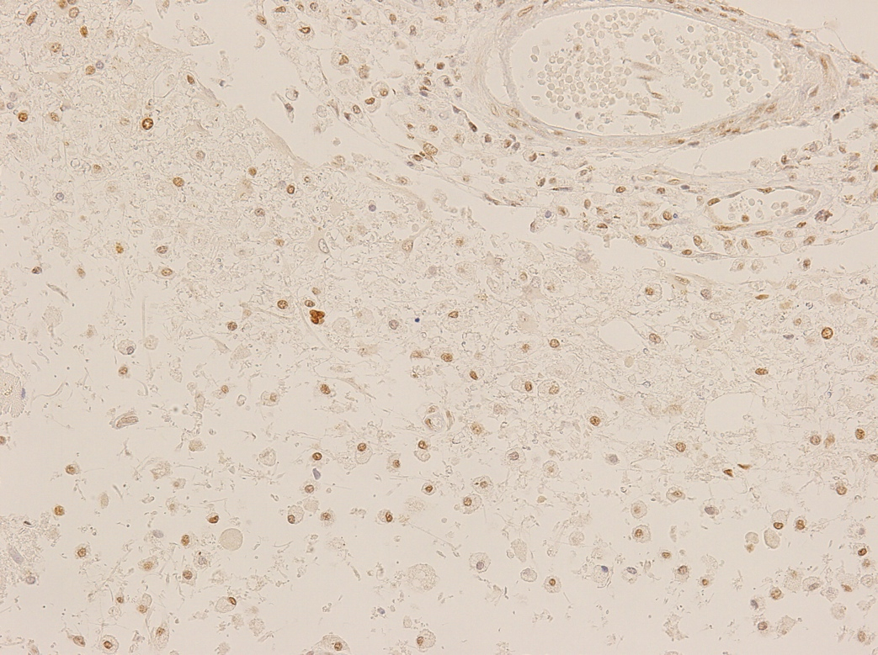
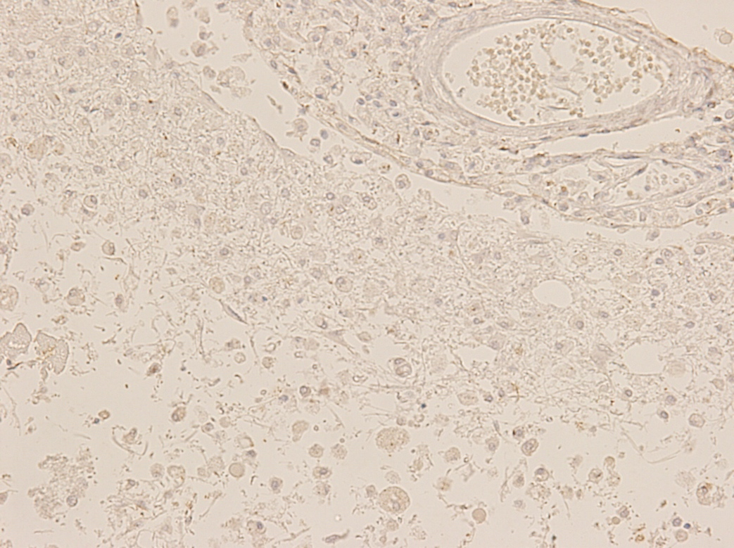
A
B
C
Figure 3.
Expression of CIRBM, RBM3 and HSP70 in the infarction with remarkable macrophages and tissue loss in the cerebral cortex.
CIRBM (A) and HSP70 (C) were weakly expressed in some macrophages and RBM3 (B) was intensively expressed in the cells and endothelial cells of blood vessels.

Slide 4
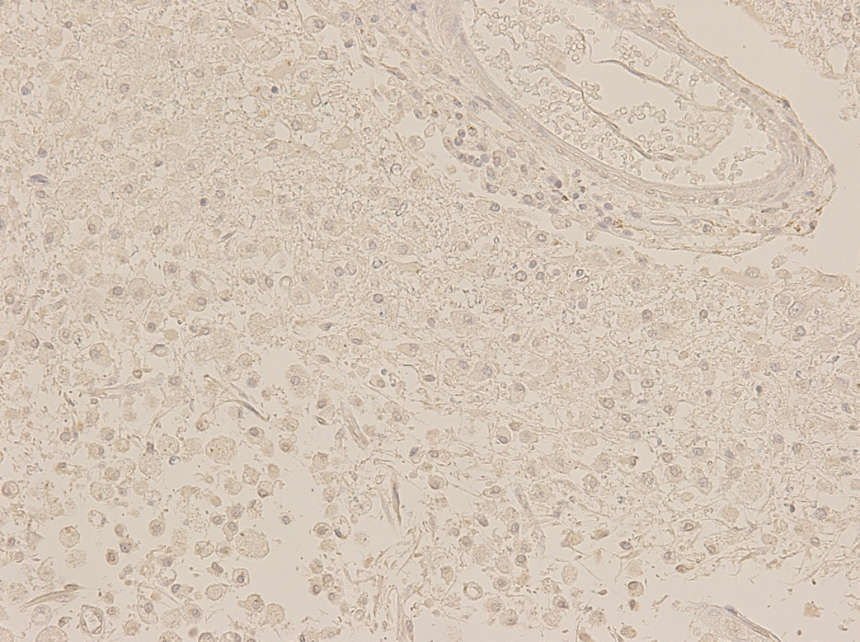
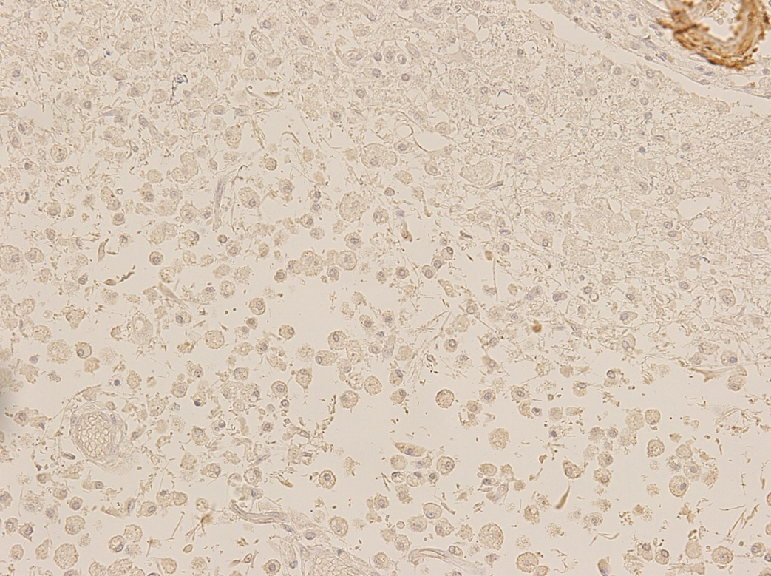
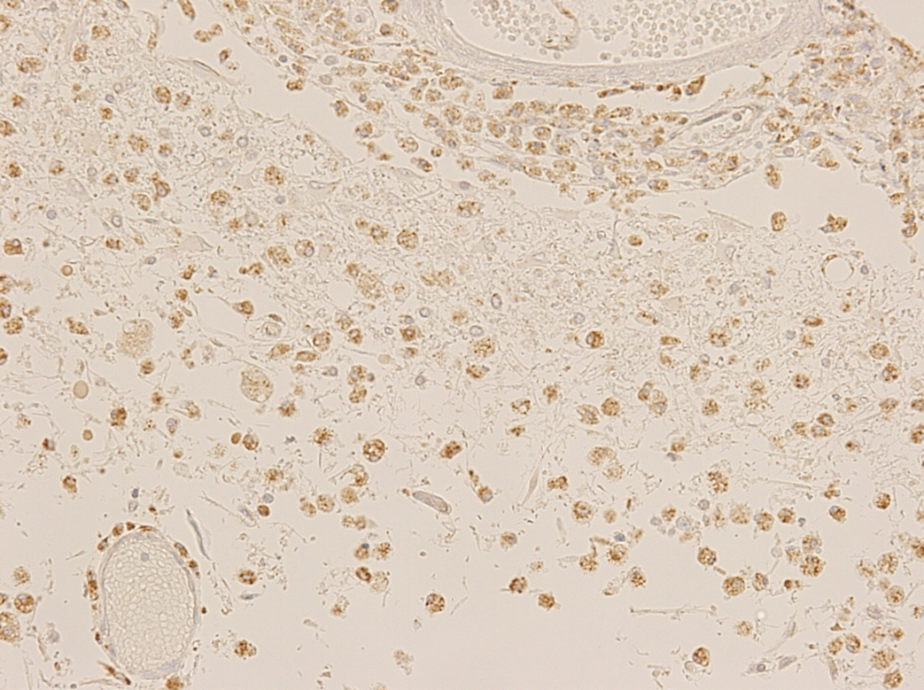
A
B
C
Figure 4.
Expression of HIF1, VEGF and
eNOs in the infarction with remarkable macrophages and tissue loss in the
cerebral cortex.
Although expression of HIF1 (A) was feeble,
that of VEGF (B) was weak and that of eNOs
(C) was clearly in macrophages. Expression of eNOs was stronger than that of infarction
with bleeding and expressed in the endothelial cells.

Slide 5
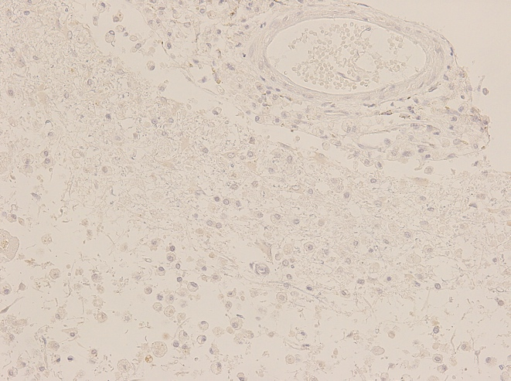
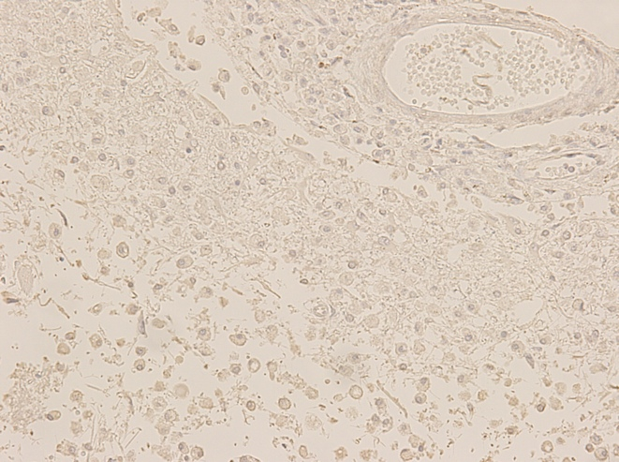
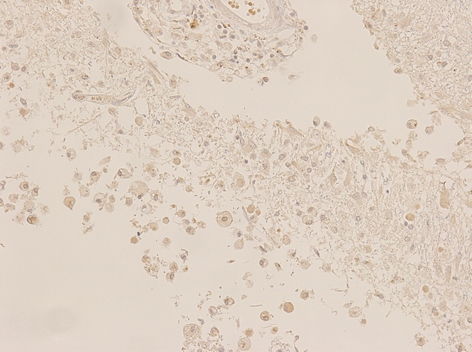
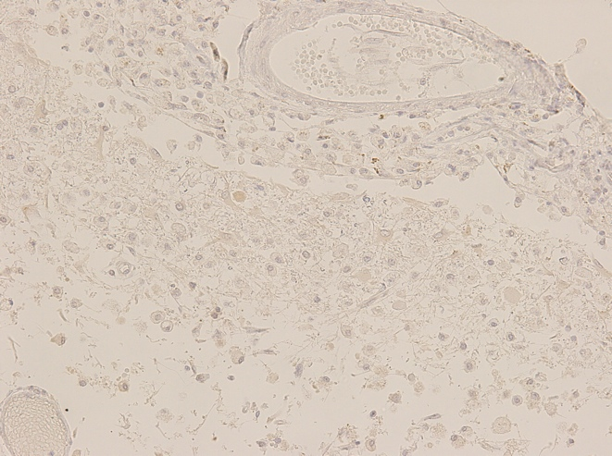
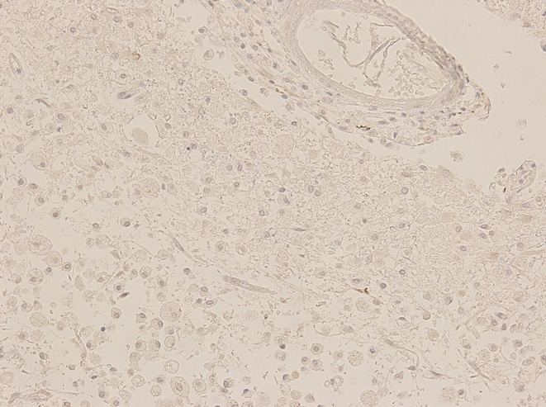
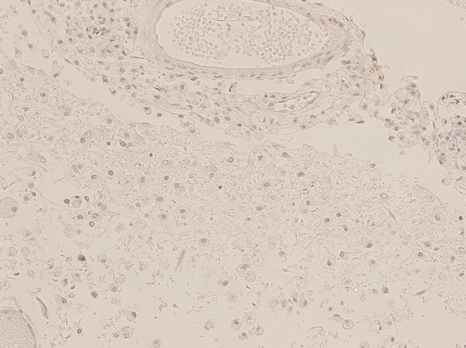
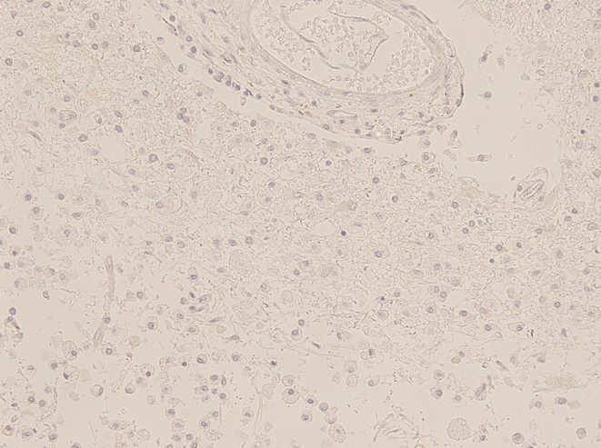
A
B
C
D
E
F
G
Figure 5.
Expression of Ngb(A), Wnt(B), AIF1(C), cFos(D), p53(E), SIRT1(F), and CCC9(G) in the infarction with remarkable macrophages and tissue loss in the cerebral cortex.
Expressions of Ngb, Wnt ,AIF and cFos were weakly
detected, p53 and CCC9 were not observed, and SIRT1 was
moderately detected .

Slide 6
Table 1. Characteristics of the antibodies used in this study
Antibody | Maker | Clone | Species | AG-retrieval | incubation | AB-dilution
CIRBP | Protein Tech | 10209-2-AP | R | autoclave | overnight | 1:400
RBM3 | Protein Tech | 14363-1-AP | R | autoclave | overnight | 1:400
HSP70 | santa cruz | polyclonal | G | autoclave | overnight | 1:400
HIF-1α | Novus | NB100-479 | R | autoclave | overnight | 1:400
VEGF | Milipore | JH121 | M | autoclave | overnight | 1:400
eNOS | Gene Tex | polyclonal | R | autoclave | overnight | pre-diluted
AIF-α | LSBio | aa-593-606 | R | autoclave | overnight | 1:400
P53 | santa cruz | FL-393 | G | autoclave | overnight | 1:400
cFOS | Gene Tex | polyclonal: | R | autoclave | overnight | 1:800
Ngb | SIGMA-ALDRICH | polyclonal: | R | autoclave | overnight | 1:400
Wnt | Novus | 6F2 | M | autoclave | overnight | 1:400
SIRT1 | Novus | E104: | R | autoclave | overnight | 1:400
CCC9 | Leica | 10A6 | M | autoclave | overnight | 1:400

